Slide 1
Analysis of California Postsecondary Preparation
Caleb Thomas

Slide 2
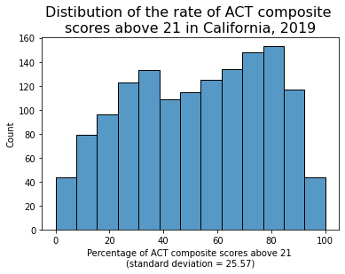
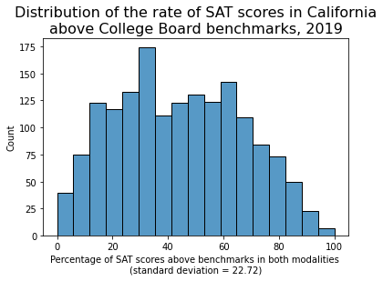
Problem Statement
This project aims to identify the best- and worst-performing California school districts on the ACT and SAT for 2019.
The insights gleaned from this project will enable the California Department of Education to not only identify possible reasons for the disparities in performance, but also direct resources to the districts in need.

Slide 3
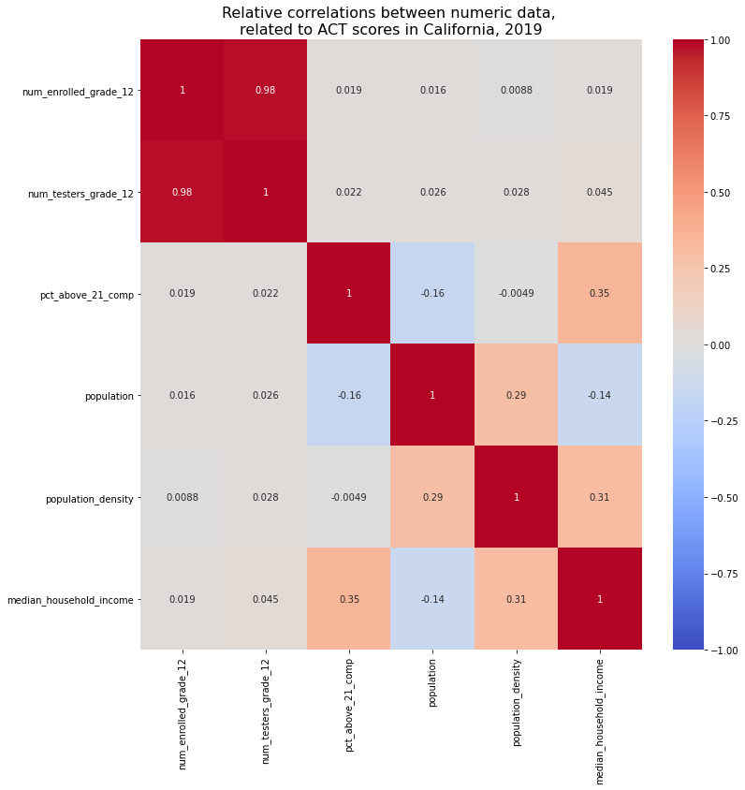

Relative Correlations
Our analysis found no significant correlations between any of the data and performance on the SAT or ACT, except for median household income.
The relationship isn’t great, but it is the strongest link in the dataset.

Slide 4
District Rankings
District | County | Median Household Income | Pct ACT Scores Above 21
Golden Plains Unified | Fresno | $45,201 | 0.00%
Reef-Sunset Unified | Kings | $47,341 | 3.57%
Tulelake Basin Joint Unified | Modoc | $38,560 | 6.67%
These are the worst-performing school districts in California for postsecondary preparation
District | County | Median Household Income | Pct SAT Scores Above Benchmark
Golden Plains Unified | Fresno | $45,201 | 0.00%
Williams Unified | Colusa | $50,503 | 0.00%
Firebaugh-Las Deltas Unified | Fresno | $45,201 | 5.95%

Slide 5
District Rankings
District | County | Median Household Income | Pct ACT Scores Above 21
Lakeside Union Elementary | San Diego | $63,996 | 100.00%
Los Gatos-Saratoga Joint Union High | Santa Clara | $93,854 | 96.17%
Piedmont City Unified | Alameda | $73,775 | 96.06%
These are the best-performing school districts in California for postsecondary preparation.
Worst Districts - $45,334.50
Best Districts - $72,869.83
~62% increase
District | County | Median Household Income | Pct SAT Scores Above Benchmark
La Canada Unified | Los Angeles | $55,870 | 91.76%
San Marino Unified | Los Angeles | $55,870 | 91.67%
Los Gatos-Saratoga Joint Union High | Santa Clara | $93,854 | 91.43%

Slide 6
Conclusions
Our analysis has indicated that the only meaningful correlation with SAT/ACT success is median household income, a correlation of ~34%.
Our recommendation to close the gap in performance is to close the gap in education spending.

